Slide 1

Clinical Trial Protocol & Amendments
William Petros, PharmD, FCCP
Professor, Schools of Pharmacy & Medicine
Associate Director for Anticancer Drug Development
Mary Babb Randolph Cancer Center
West Virginia University

Slide 2
Outline
Rationale for Clinical Trials
Preclinical Testing
Types of Clinical Trials
Elements of the Protocol

Slide 3
Why do we need clinical trials?
Clinical trials separate therapies which are true advances from false leads and clinical impressions. Importantly, they also identify risks of therapy.

Slide 4
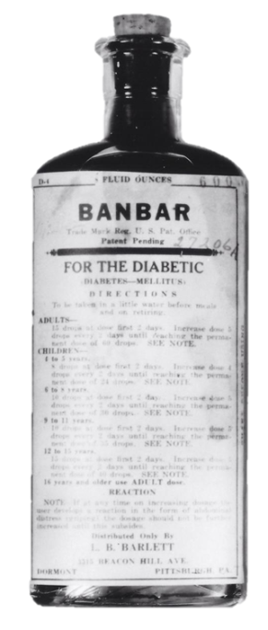

Brief History Leading to Clinical Trials
1937 Liquid formulation of sulfa drug sold with diethylene glycol, killing > 100
1938 (US FDC Act) mandated pre-market safety evaluation
1961 Case reports of thalidomide (approved in Europe) causing server birth defects and deaths
1962 Legislation mandates FDA approval contingent on “substantial evidence” of safety (first in animals and then humans) in addition to efficacy
Notes:
Banbar was an old patent medicine that was touted as a cure for DM, consisting of milk sugar and horsetail taken off market 1938

Slide 5
Clinical Trials
Prospective studies comparing the effect and value of an intervention in humans (or sometimes animals)
  Can involve drugs, devices, procedures, etc.
Informed consent required
In some settings, these are considered the standard of care e.g. many pediatric malignancies

Slide 6
What Is the focus of a clinical drug trial?
Examples:
Effectiveness of intervention to treat a disease
Safety of a new drug
Defining dose administration
Testing drug formulation
Exploring combination therapies
Evaluating effect of therapies on quality of life

Slide 7
Rationale for Clinical Trials
Need….
“If you don’t want to practice medicine 10 years from now the same way we do it today then clinical research must be a priority.” (MH Jan 2013)
Approach….
Animal studies are of limited value in determining the full spectrum of toxicities and predicting effectiveness of treatments in humans

Slide 8
Outline
Rationale for Clinical Trials
Preclinical Testing
Types of Clinical Trials
Elements of the Protocol

Slide 9
Contents of a full Investigational
New Drug Application (IND)
1. Form FDA 1571
2. Table of Contents
3. Introductory statement
4. General Investigational plan
5. Investigator’s brochure
6. Protocol
  a. Study protocol
  b. Investigator data or completed Form FDA 1572
  c. Facilities data or completed Form FDA 1572
  d. Institutional Review Board data or completed Form FDA 1572
7. Chemistry, manufacturing, and control data
8. Pharmacology and toxicology data
9. Previous human experience
Notes:
I am beginning with the end of clinical testing…the ind. This is what you need to know before you can put the drug in humans

Slide 10
Overview of Pre-Clinical Anti-Cancer
Drug Development
Cell Culture
Animal Tumor Models
Human Xenografts
Pharmaceutics & Tox
Human Clinical Trials

Slide 11
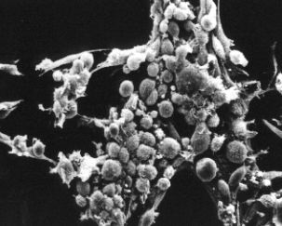
Pre-Human Testing
Mix drug with cancerous and normal cells grown in lab

Slide 12
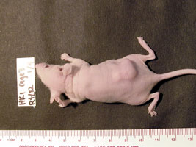
Pre-Human Testing
Evaluation of drug in animals
  Effectiveness
  Toxicity

Slide 13
Outline
Rationale for Clinical Trials
Preclinical Testing
Types of Clinical Trials
Elements of the Protocol

Slide 14
Types of Clinical Trials
Therapeutic:
Treatment
  Test new approaches to treat a disease
Prevention
  What approaches can prevent disease
Non-therapeutic:
Early-detection/screening
  What are new ways to find hidden disease
Diagnostic/Prognostic/Epidemiologic
  How can new tests or procedures ID disease

Slide 15
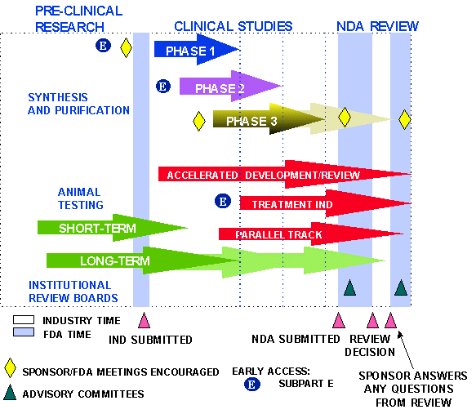
http://www.fda.gov/cder/handbook/develop.htm
Post-marketing studies

Slide 16
Overview of Clinical Drug Development
Pre-clinical
Phase I
Safety/Early Activity/Pcol/Dosing
Phase II
Activity/Safety/Dosing
Phase 0
Phase III
Tx Improvement
MOA
FDA Approval

Slide 17
Phase I Trials
Goals:
  Evaluate the nature of toxicities
  Determine the “maximally tolerated dose” or “optimal biologic dose” or alternative target
  Identify a feasible schedule of administration
  Investigate the way in which the drug distributes and is eliminated from the body
  Observe any anti-tumor effects
  Investigate surrogate response markers

Slide 18
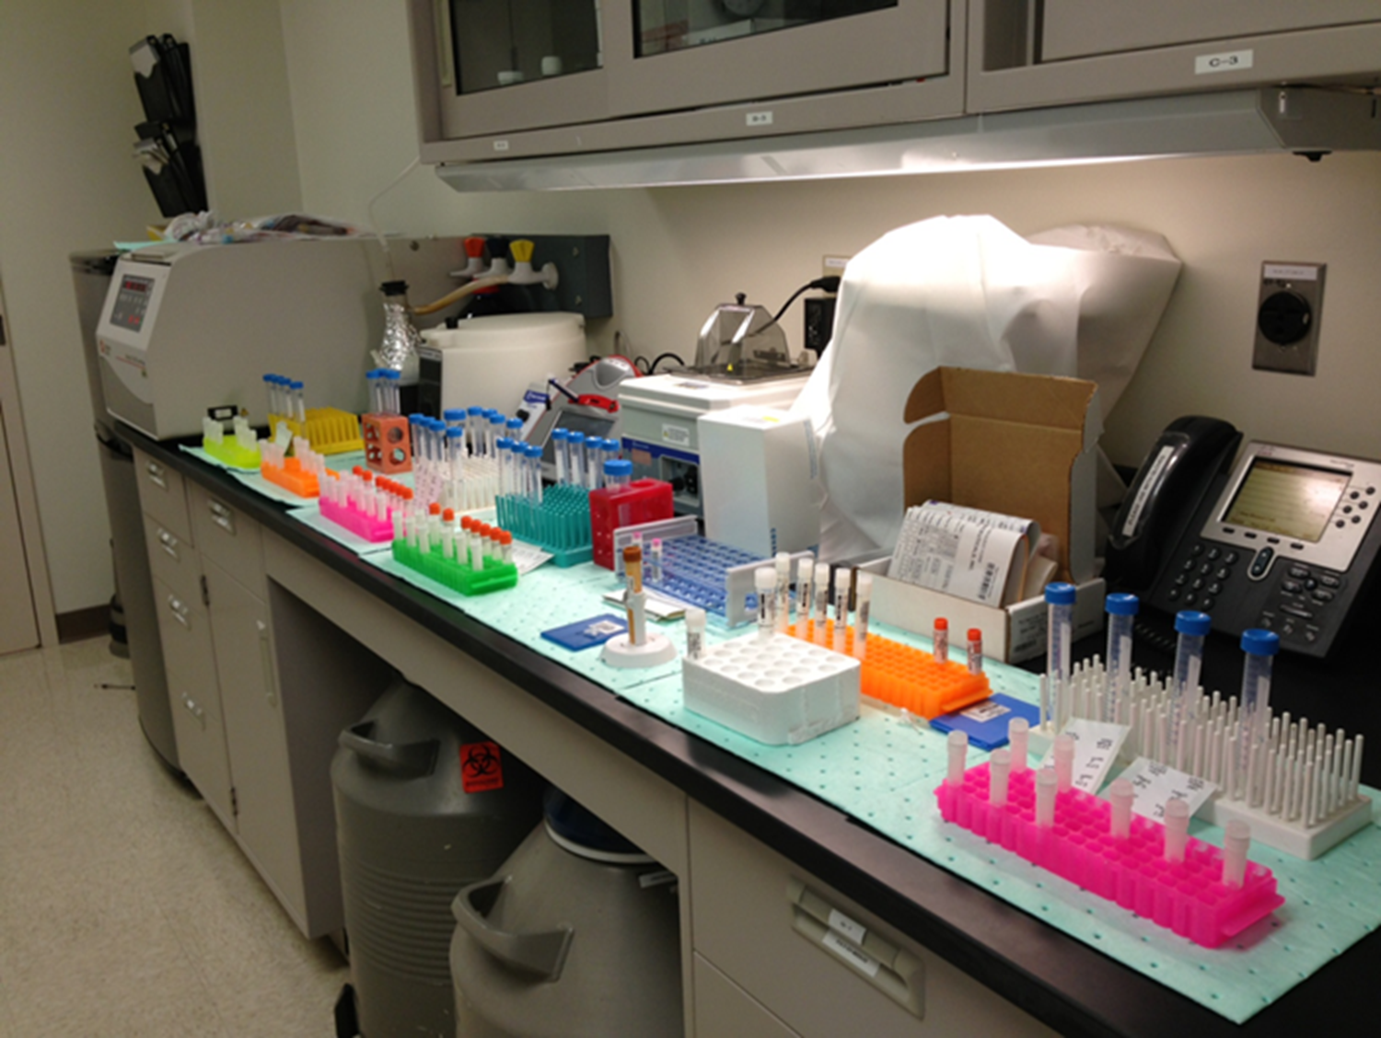
Common Issues Addressed by Clinical Pharmacology Studies in the Drug Development Process
Phase I
    Bioactive concentrations, in vitro vs. vivo
    Human metabolism & renal influence
    Intra-patient and inter-patient variability
    Weight/BSA associations
    Bioavailability
    Linearity
    Pharmacodynamic surrogate
    Pharmacogenomics

Slide 19
Phase I Trials (continued)
Patients:
  Normal volunteer (non cancer)
  Relapsed following typical anti-cancer therapies
  Newly diagnosed cancers with no effective therapy
  May be required to “overexpress” the target
Design:
  Single-Drug
  Combination (new and old drug)

Slide 20
Phase I Trials (continued)
Single anti-cancer drug design:
  E.g. Treat 3 patients at a very low dose, if acceptable toxicity, then double dose to next group of patients
  Intra-patient does escalations atypical
Multiple anti-cancer drug design:
  Same as above but escalate doses for each agent individually

Slide 21
Typical Dose-Limiting Toxicity Criteria for an Anti-Cancer Drug
ANC < 500 for > 5-7 days
ANC < 1000 + fever of 38C or above
PLT < 10K or 25K
Grade 3-5 non-hematologic toxicity
Inability to retreat within 2 weeks of schedule secondary to toxicity

Slide 22
Phase I Endpoints for
Non-Traditional Anti-Cancer Drugs*
Dose-limiting toxicity (DLT)
Target plasma concentration
Saturation of drug clearance (monoclonals)
Elucidation of a pharmacologic (surrogate) effect in either normal or malignant cells
*Dose-response could be non-monotonic

Slide 23
Phase I Trials (continued)
Information needed for next phase:
  Appropriate dose and schedule
  Refined toxicity monitoring parameters
  Suggestions for activity in specific malignancies
  Identification of surrogate markers for activity

Slide 24
Phase II Trials
Goals:
  Determine the effectiveness in specific types of cancer and compare this to literature on other drugs
  Further refine the dose & schedule of administration
  Evaluate the nature of toxicities when given for a longer term
  Evaluate associations of surrogate markers with response

Slide 25
Phase II Trials (continued)
Patients:
  Non-responders or relapsed following a typical therapy
  Initial therapy for some cancers that have spread beyond the initial site
  May be required to “overexpress” the target
Design:
  30-60 patient studies with therapy given over several months to evaluate anti-cancer response

Slide 26
Phase II Trials (continued)
Structure
  Single arm, historic control
  Targeted biologic endpoint
  Single arm, intra-patient control
  Randomized vs. other anti-cancer agents
  Randomized discontinuation
  Cross over, double-blind

Slide 27
Common Issues Addressed by Clinical Pharmacology Studies in the Drug Development Process
Phase II
    Dose optimization
    Schedule optimization
    Patient compliance
    Pharmacometrics
    Pharmacogenomics
    Interactions
      (drugs, disease, excipients, herbals, food, etc.)

Slide 28
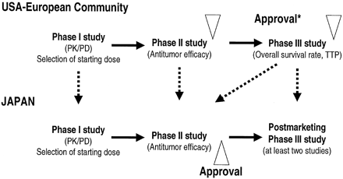
Accelerated Approval May Occur After Phase II
Schwartsmann, et al. JCO, 2002

Slide 29
Phase III Trials (continued)
Patients:
  Wider eligibility criteria
  Initial diagnosis of cancer or situations where initial chemotherapy is indicated
  May be required to “overexpress” the target
Design:
  Large numbers of patients randomized to receive investigational therapy or placebo vs. the standard
  Non-inferiority vs. equivalency vs. superiority

Slide 30
Phase III Trials (continued)
Typical sites:
  Large, academic cancer centers
  Some smaller cancer centers
  Some larger private practice groups
  Cooperative groups
File NDA once successfully completed

Slide 31
Post-Approval Studies (Phase IV)
Drug-drug interactions
Drug-food interactions
Drug-herbal interactions
Pharmacoeconomic
Expanded safety/efficacy
Additional indications
Strategies for minimization of adverse effects
Strategies for dose-individualization
Optimization of surrogate lab tests
Special populations
New formulations

Slide 32
Outline
Rationale for Clinical Trials
Preclinical Testing
Types of Clinical Trials
Elements of the Protocol

Slide 33
Elements of the Protocol
Title page
  Title
  Investigators/team
  Number, version, date
  IND # (if applicable)
  Institutions of conduct
  Sponsor
Schema*
  Overview of treatment regimen
Table of Contents
Objectives
  Clearly stated
  Primary
  Secondary
  Tertiary (exploratory)
Background
  Key studies
  Not an exhaustive review
Rationale/Justification
  Objectives
  Overall design
  Ancillary studies
  Unique methods
  Population
  Doses
Eligibility Criteria
Notes:
*Often there is a few page protocol summary placed just after the schema
Include bg/justif for all objectives and doses used in the study +/- methods if not standard.

Slide 34
Eligibility Criteria/Study Population
Clear and verifiable eligibility criteria that are not too narrow, yet address the objective(s) without inflicting too much heterogeneity
  Inclusions
    e.g. diagnosis, extent (spread) of disease, measurability of disease, age, anticipated survival, tumor genetics, “adequate” organ function, informed consent, etc.
  Exclusions
    e.g. concomitant disease(s), prior treatments, pregnancy, poor “performance status” etc.
Notes:
Don’t want to get too far away from the real world if you don’t have to for both translatability and screening failure reasons

Slide 35
Elements of the Protocol
Title page
  Title
  Investigators/team
  Number, version, date
  IND # (if applicable)
  Institutions of conduct
  Sponsor
Schema*
  Overview of treatment regimen
Table of Contents
Objectives
  Clearly stated
  Primary
  Secondary
  Tertiary (exploratory)
Background
  Key studies
  Not an exhaustive review
Rationale/Justification
  Objectives
  Overall design
  Ancillary studies
  Unique methods
  Population
  Doses
Eligibility Criteria
Treatment plan/Study design
  Administration schedule/doses
  Schedule/dose modifications
  Duration of therapy

Slide 36
Typical Study Design Features
Treatment sequences
  e.g. single, parallel, crossover, withdraw, survival
Blinding/masking
  e.g. open label, single blind, double blind, double dummy
Control
  e.g. hx, no tx, dose response, active, placebo
Methods of assigning treatment
  e.g. randomization +/- stratification

Slide 37
Elements of the Protocol (continued)
Supportive care
Pharmaceutical info
  Procurement/supply
  Preparation
  Storage & stability
  Administration route
  Adverse effects
  Drug interactions
On study procedures
  Registration
  Randomization
  Stratification factors
Adverse events
  List (labs vs. symptoms)
  Reporting requirements
  Data & safety monitoring plan

Slide 38
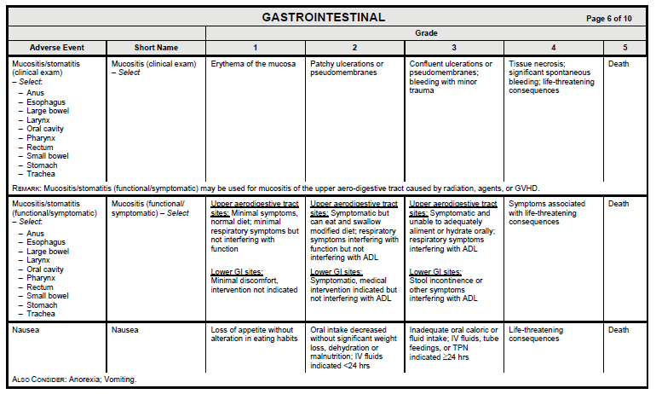
NCI’s Common Terminology Criteria for Adverse Events (CTCAE)

Slide 39
Adverse Events
Adverse Event
  Any untoward medical occurrence associated with the use of a drug in humans, whether or not considered drug related
  Labeled an Adverse Reaction if thought to be caused by the drug
  Unexpected Adverse Event if not listed in the investigators’ brochure or at the specificity or severity observed
Serious Adverse Event
  Death, life-threatening, hospitalization (or prolongation), persistent or significant disability, congenital/birth defect, medically important that jeopardizes patient and need intervention to prevent previous issues (e.g. bronchospasm requiring intensive o/p treatment)
  Severe not necessarily serious (e.g. gr 3 headache)
Life Threatening Event
  Places patient at immediate risk of death

Slide 40
Data & Safety Monitoring Plan
Required in all NIH supported clinical trials and typical in many pharma phase III studies
Ensures patient safety, data validity and appropriate termination of studies if undue risks or if the trial cannot be completed successfully
Required Elements
  Delineation of oversight responsibilities (internal vs external)
  Description of data and safety review process
  Time table for submission of data, safety, and progress information
  Process to implement closure/suspension when significant risks/benefits are identified
  Description of adverse event reporting procedures

Slide 41
Elements of the Protocol (continued)
Supportive care
Pharmaceutical info
  Procurement/supply
  Preparation
  Storage & stability
  Administration route
  Adverse effects
  Drug interactions
On study procedures
  Registration
  Randomization
  Stratification factors
Adverse events
  List (labs vs. symptoms)
  Reporting requirements
  Data & safety monitoring plan
Response criteria

Slide 42
Common Oncology Trial Endpoints/Outcomes
Overall survival
Progression free survival
Time to progression
Time to treatment failure
Disease specific survival
Complete response
Durable complete response
Partial response
Overall response rate
Stable disease
Progressive disease
Biomarker based

Slide 43
Elements of the Protocol (continued)
Supportive care
Pharmaceutical info
  Procurement/supply
  Preparation
  Storage & stability
  Administration route
  Adverse effects
  Drug interactions
On study procedures
  Registration
  Randomization
  Stratification factors
Adverse events
  List (labs vs. symptoms)
  Reporting requirements
  Data & safety monitoring plan
Response criteria
Schedule of events/procedures
Off study criteria
Correlative studies (e.g. biomarkers, pk, etc.)
Notes:
Schedule of events i.e. the calendar

Slide 44
Elements of the Protocol (continued)
Statistical considerations
  Randomization (+/- stratification)
  Sample size (power analysis)
  Accrual rate (duration)
  Analytic plan (primary and other objectives)
  Expected outcomes
  Interim analysis
  Stopping rules
Records retention guidelines
References
Informed consent
Appendices
  e.g. eligibility checklist, toxicity monitoring criteria, tumor response criteria, lists of interacting drugs, questionnaires, etc.

Slide 45
Elements of the Protocol (continued)
Amendments
  Summary of changes in front of protocol or as a stand alone document
  Revised protocol must be approved by IRB (and PRMC) before implementation
  General types
    Safety notice
    General requests
    Action letters
Notes:
Safety notice e.g. multicenter protocol where and ae has been filed with fda
Action letters require some sort of reaction by the pi

Slide 46
I have great idea & strategy but do I have…….
The appropriate patient population
Collaborating within and interdisciplinary faculty
Facilities/Cores to conduct the study
Supportive clinical staff
Time/administrative buy in
Funding
Legal/contractual issues

Slide 47

www.wvctsi.org
Made possible by IDeA CTR support –
NIH/NIGMS Award Number U54GM104942
West Virginia Clinical and Translational Science Institute

