Slide 1
Good Clinical Practice (GCP)
Sponsor Roles & Responsibilities

Slide 2

Today’s Agenda
Quick Review of FDA Regulations
High-level Definitions of Sponsor vs. Investigator vs. Sponsor-Investigator
Sponsor Responsibilities- Helicopter View
Reasons for Acquiring IND and Types of IND
Content of IND
Sponsor Responsibilities on FDA Submissions
Sponsor Responsibilities on Monitoring the Trial
Sponsor Responsibilities on IRB Review
Investigator Responsibilities that the Sponsor Needs to Verify
Drug Accountability
Record retention
Investigator responsibilities- CAPA
Violations Noted by FDA on Audits
IND Exemptions
Brain Teasers
Q&A

Slide 3
Lecture Disclaimer
The views presented at this seminar represent the generally accepted industry framework on following GCP/ IHC prescribed practices as they pertain to the sponsor responsibilities. Variations in procedural applications of the requirements may vary from company to company. But the essence of compliance remains central to all drug and device industries.

Slide 4
FDA Regulations
21 CFR §11 Electronic Records; Electronic Signatures
21 CFR §50; 45 CFR 46 Protection of Human Subjects
21 CFR §54 Financial Disclosure by Clinical Investigators
21 CFR §56 Institutional Review Boards
21 CFR §58 Good Laboratory Practices
21 CFR §211, § 810 Good Manufacturing Practices
21 CFR §1271 Good Tissue Practices

Slide 5
FDA Regulations
Investigational Application
21 CFR §312 IND Drugs and Biologics
21 CFR §812 IDE Devices
21 CFR §809 IVD In Vitro Diagnostics
Marketing Application
21 CFR §601 BLA Biologics
21 CFR §314 NDA Drugs
21 CFR §814 PMA Devices

Slide 6
Definitions
        Sponsor means an individual who takes responsibility for and initiates a clinical investigation. The sponsor may be an individual or pharmaceutical company, governmental agency, academic institution, private organization, or other organization. The sponsor does not actually conduct the investigation unless the sponsor is a sponsor-investigator. The sponsor is not the “funding organization” by FDA definitions. 21 CFR 312.3 (b)
Investigator is an individual under whose immediate direction a drug is administered or dispensed -21 CFR 312.3 (b)
  Sponsor-Investigator is an individual who both initiates and conducts an investigation. The requirements/responsibilities under this part include both those applicable to an investigator and a sponsor. 21 CFR 312.3 (b)

Slide 7
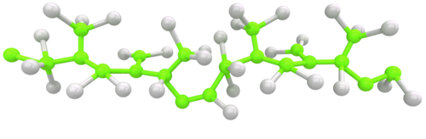
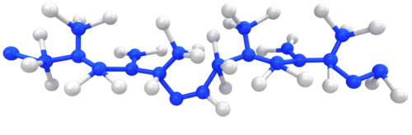
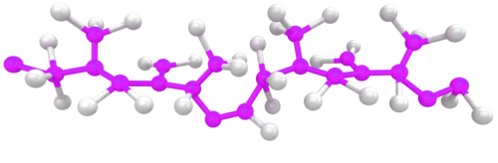



Three Scenarios
Dr. Jones wrote the protocol, submitted the IND, and is the only PI conducting the study. The drug was supplied by a private pharmaceutical company. Dr. Jones is a
A) Investigator
B) Sponsor
C) Sponsor-Investigator
Dr. Jones is conducting a study for WV Pharmaceuticals. They hold the IND and provide the study drug. Dr. Jones provided advice in developing the protocol. Dr. Jones is a(n):
A)Investigator
B)Sponsor
C)Sponsor-investigator
WV Pharmaceuticals is supplying the drug and holds the IND. A private foundation is paying for the study. Dr. Jones wrote the protocol for WV Pharmaceuticals and the company submitted it to the IND. Dr. Jones is conducting the study at his institution.
Who is the regulatory sponsor?
Who is the financial sponsor?
Who is Dr. Smith?

Slide 8
Sponsor Responsibilities
Submit necessary amendments/supplements to FDA
Ensure that FDA and all participating investigators are promptly informed of significant new adverse effects or risks
Maintain adequate records
Maintain proper control of the study drug/device
Providing GMP-level drug products to investigator
Select qualified investigators at other institutions for multi-site trials
Provide information to other investigators and study staff to ensure that the study is performed properly
Ensure proper monitoring of the study
Ensure the study is performed in accordance with the general investigational plan and protocol

Slide 9
IND & Clinical Investigation
  Investigational drug (also known as Investigational New Drug- IND): drug or biological drug that is used in a clinical investigation.
  Clinical Investigation: any experiment in which a drug is administered or dispensed to, or used involving, one or more human subjects (an experiment is any use of a drug except for the use of a marketed drug in the course of medical practice).
An IND is a request for FDA authorization to administer an investigational new drug to humans
  Such authorization must be secured prior to interstate shipment and administration of any unapproved drug

Slide 10
Reasons For Acquiring an IND?
It affirms a body of knowledge about the manufacturing, pharmacology, and toxicology of the drug to support its use in human testing
Requires that the clinical investigation be performed in accordance with Good Clinical Practice (GCP)
Provides an additional level of protection through FDA oversight
  FDA’s review focuses on safety of human subjects and ensuring that the studies will produce useful information to assess safety and efficacy of the test product

Slide 11
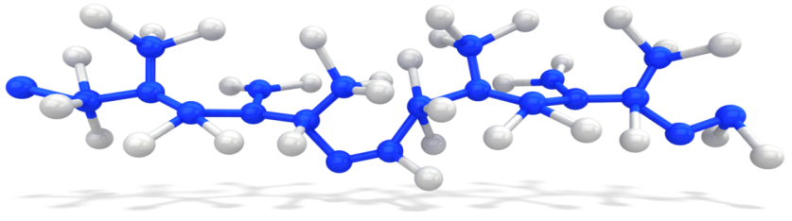

Types of IND:
Treatment IND (21 CRF 312.320)
  Investigational New Drugs are used to make promising new drugs available to desperately ill patients as early in the drug development process as possible
  FDA will permit an investigational drug to be used under a treatment IND if there is:
  preliminary evidence of drug efficacy, drug is intended to treat a serious or life-threatening disease, or
  there is no comparable alternative drug or therapy available to treat that stage of the disease in the intended patient population
Expanded Access: Single patient INDs
  sometimes called "compassionate use"
  use of an investigational drug outside of a clinical trial to treat a patient with a serious or immediately life-threatening disease or condition who has no comparable or satisfactory alternative treatment options

Slide 12
Content of IND
  Cover Sheet (Form FDA 1571)
  Table of Contents
  Introductory Statement and General Investigational Plan
  Investigator’s Brochure
  Clinical Protocol
  Chemistry, Manufacturing and Control (CMC)
  Pharmacology and Toxicology Information
  Previous Human Experience
  Clinical Trials Certification of Compliance (Form FDA 3674)
  Additional Information

Slide 13
FDA Form 1571 (CFR 21, 312.23 (a)(1)(i-ix))
Contractual agreement between sponsor and FDA
Contains name of person responsible for conduct and progress of the study (Item 15)
Contains name of person responsible for the review and evaluation of information relevant to the safety of the drug (Item 16)
Sponsor or sponsor’s authorized representative agrees to conduct investigation in accordance with all applicable regulatory requirements (Item 17)

Slide 14
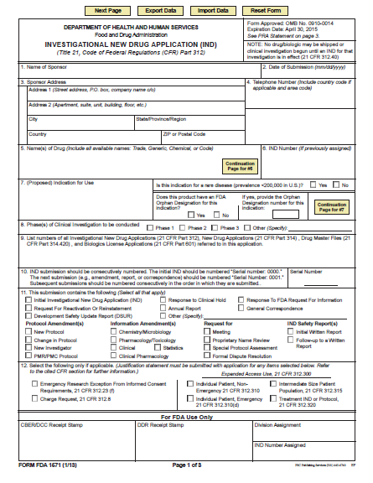
FDA Form 1571

Slide 15
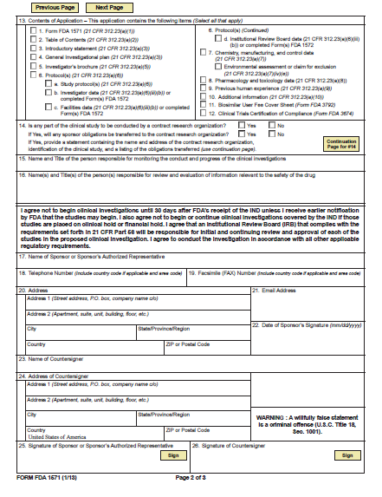
FDA Form 1571

Slide 16
Introductory Statement & General Investigational Plan
(21 CFR 312.23(a)(3))
Information about the drug
Brief summary of previous human experience
If the drug has been withdrawn from investigation or marketing in any country
Brief description of the overall plan for investigating the drug product for the following year

Slide 17
Investigator’s Brochure
The regulations pertaining to providing investigators with an investigator brochure are found in 21 CFR 312.55 and 312.23(a)(5).
Sec. 312.55 Informing investigators.
Before the investigation begins, a sponsor (other than a sponsor-investigator) shall give [Emphasis added.] each participating clinical investigator an investigator brochure containing the information described in Sec. 312.23(a)(5).
The sponsor shall, as the overall investigation proceeds, keep each participating investigator informed of new observations discovered by or reported to the sponsor on the drug, particularly with respect to adverse effects and safe use. S
Sponsor should distribute such information to investigators by means of periodically revised investigator brochures, reprints or published studies, reports or letters to clinical investigators, or other appropriate means. I
Important safety information is required to be relayed to investigators in accordance with Sec. 312.32.

Slide 18
Study Protocol & CMC & Phamacology
(21 CFR 312.23(a)(6))
The recipe book to the conduct of the trials
(21 CFR 312.23(a)(7))
Section describing the composition, manufacture, and control of the drug substance and the drug product
Regulations are specific based on what phase of the investigation you are at (i.e., the requirements for a Phase I study are much different than the requirements for a Phase III study)
(21 CFR 312.23(a)(8))
Adequate information about pharmacological and toxicological studies of the drug involving laboratory animals or in vitro, on the basis of which the sponsor has concluded that it is reasonably safe to conduct the proposed clinical investigations

Slide 19
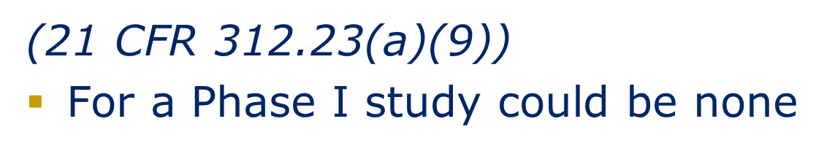
Additional Compliance Requirements
Previous Human Experience
Additional Information
Certification of Compliance
(21 CFR 312.23(a)(10))
(i)Drug dependence and abuse potential (ii)Radioactive drugs
(iii)Pediatric studies
(Form FDA 3674)=clinicaltrials.gov

Slide 20
Sponsor: IND Amendments
IND Amendment (Documents submitted to an active IND)
The 4 major types are…
Protocol Amendments (21 CFR §312.30)
Information Amendments (21 CFR § 312.31)
IND Safety Reports (21 CFR § 312.32)
IND Annual Reports (21 CFR § 312.33)

Slide 21
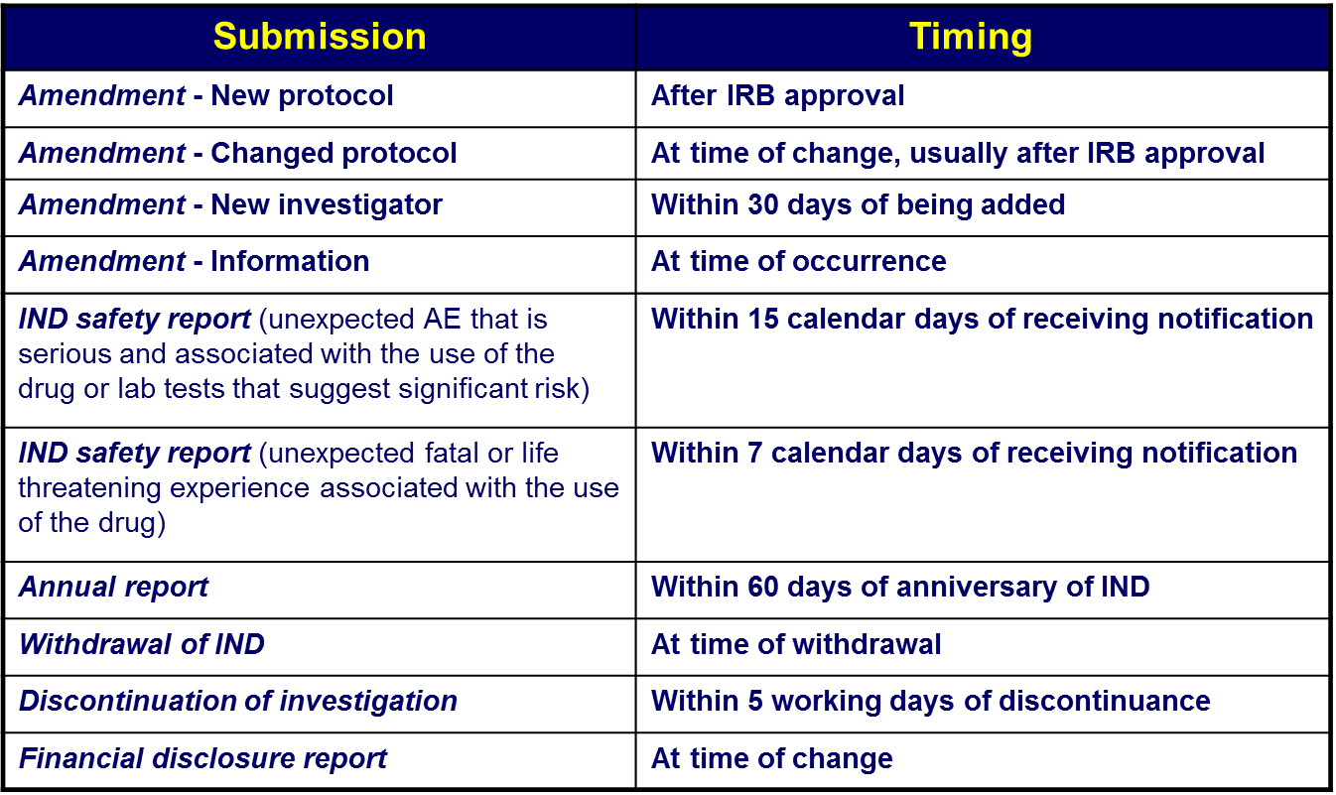
Sponsor Responsibilities: FDA Submissions

Slide 22
Amendment- New Protocol
New study that is not covered by a protocol already contained in the IND
Must submit the new protocol to the FDA
The new protocol can begin after both conditions have been met:
  The protocol has been approved by the IRB
  The sponsor has submitted the protocol to the FDA for its review
    There is no need to wait for the 30 day review period at the FDA unless we have specifically asked the FDA for advice on the protocol content

Slide 23
Amendment- Changes in a Protocol
A sponsor shall submit a protocol amendment describing any change in a Phase I protocol that significantly affects the safety of subjects or any change in a Phase 2 or 3 protocol that significantly affects the safety of subjects, the scope of the investigation, or the scientific quality of the study
Examples:
  Any increase in drug dosage or duration of exposure of any individual subjects
  Any significant increase in the number of subjects under study
  Any significant change in the design of a protocol (the addition or dropping of a control group)
  The addition of a new test, or procedure, that is intended to improve monitoring for, or reduce the risk of, a side effect or adverse event; or the dropping of a test intended to monitor safety

Slide 24
Amendment- Changes in a Protocol (Continued)
A protocol change may be implemented provided the following two conditions are met:
  The change has been approved by the IRB with responsibility for review and approval of the study
  The sponsor has submitted the change to FDA for its review
    No need to wait 30 days unless sponsor specifically asks for feedback
  IRB Minor Amendment: URGENT REQUEST

Slide 25
Amendment-New Investigator
A sponsor shall submit a protocol amendment when a new investigator is added to carry out a previously submitted protocol
The sponsor shall notify FDA of the new investigator within 30 days of the investigator being added
Try to group new investigators/and or sites together
Also includes new lab, new clinic
Can submit together with a change in protocol or new protocol submission
Required paperwork
  Form 1572
  Investigator CV – signed and dated on first page

Slide 26
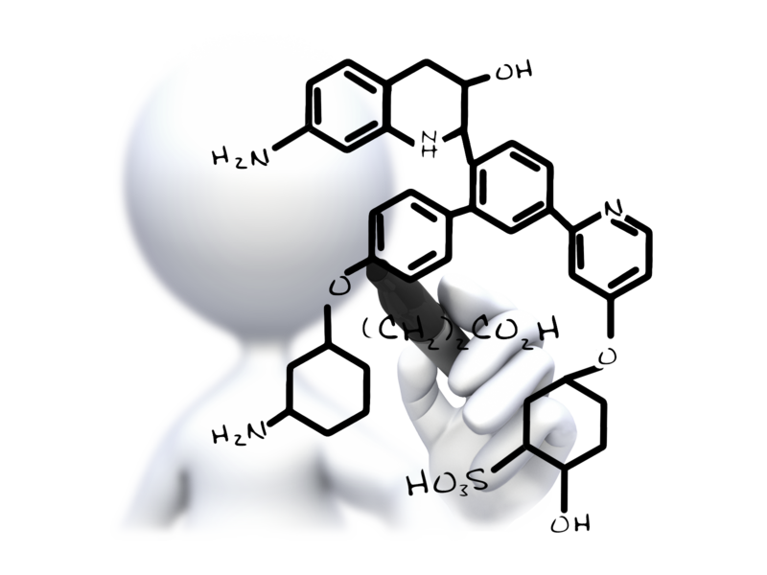
Amendment- Information (21 CFR 312.31)
New toxicology, chemistry, or other technical information
New Investigator’s Brochure
Submit at the time of change, but, to the extent feasible, not more than every 30 days
Can submit with protocol amendment or new investigator amendment with Form 1571.

Slide 27
IND Safety Report (21 CFR 312.32)
Unexpected fatal or life threatening suspected adverse reactions
  Must submit to the FDA within 7 calendar days of receiving the notification
  Complete MedWatch 3500 A
  Follow-up reports must be submitted as soon as possible
Unexpected serious suspected adverse reactions
  Must submit to the FDA within 15 calendar days of receiving the notification
  Complete MedWatch 3500A
Follow-up reports should be submitted within 15 days of receiving the first notification (not required if 7 day report is complete)
If FDA requests any additional data or information, the sponsor must submit it to the FDA as soon as possible, but no later than 15 calendar days after receiving the request
Contact the IRB

Slide 28
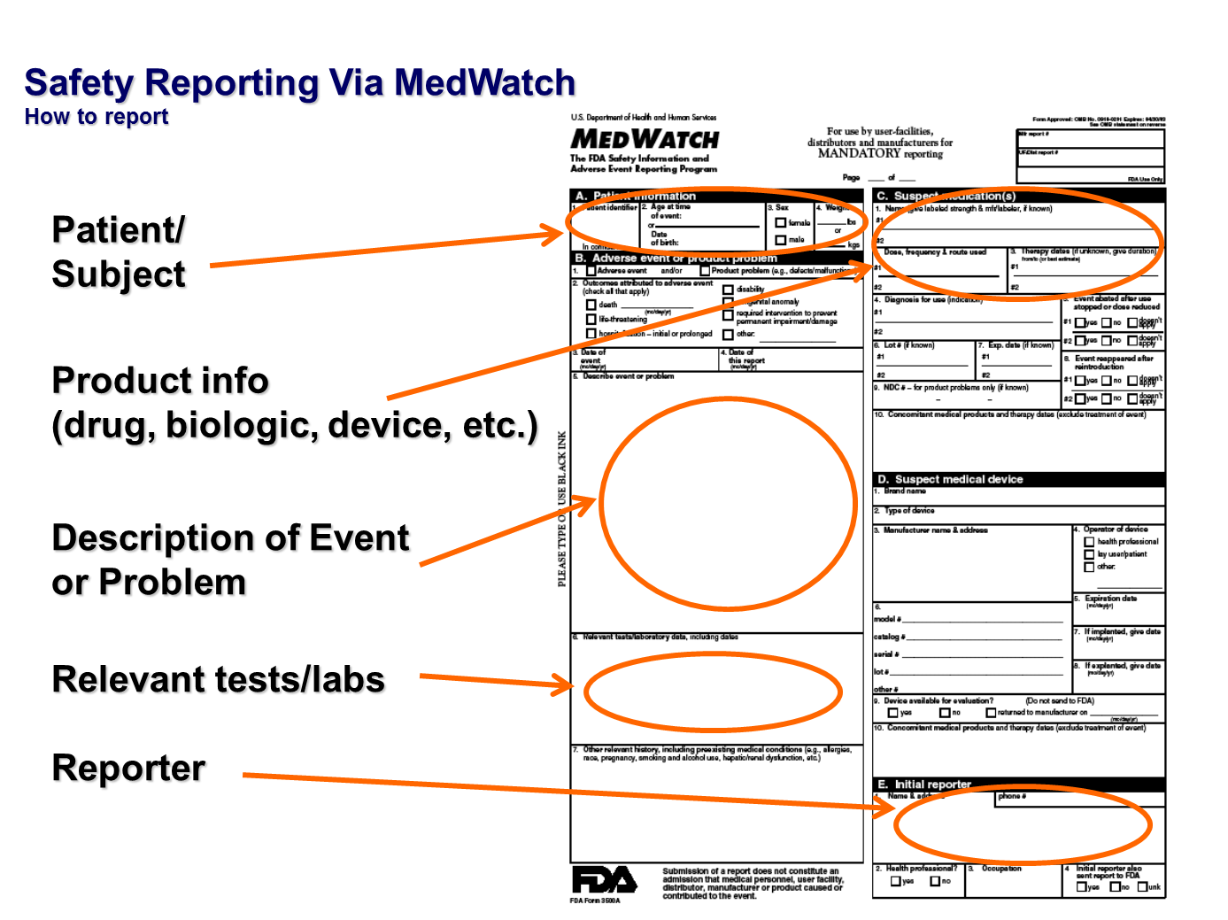

Slide 29
Annual Report (21 CFR 312.33)
Due to the FDA within 60 calendar days of the IND Anniversary Date (date IND was deemed “safe to proceed”)
The sponsor will gather the information through the PI
  Patient demographics
  Study information (number of patients enrolled, number of sites, etc.)
  Adverse events
  Any other new information
Sponsor will complete the annual report template and send to study it to PI along with FORM 1571 to review
The sponsor will send final annual report to the FDA with Form 1571

Slide 30
Sponsor: Monitoring the Trial
Clinical Trial Monitoring is required for clinical trials conducted under an IND
Clinical Trial Monitor examines quality of trial conduct:
  Selection of qualified PI and experience (Form 1572) along with Investigator CV and licensures.
  Perform on-site (if indicated, also off-site) evaluations of trial-related activities
  Identify deviations in protocol conduct
  Review documents for Adverse Events
  Accurate records of financial disclosure (21CFR 54)- FDA Form 3455 for PI and Form 1572 for Sub-Investigators
  Drug accountability – shipping of investigational products
Extent and frequency of monitoring as appropriate:
  Length, complexity, subject enrollment and other aspects of the trial

Slide 31
Sponsor: Monitoring the Trial
Ensure PI compliance or discontinue shipment of the investigational drug/ Device. This will require documentation and safety monitoring
Review evaluate drug/ device safety and effectiveness as to who will be reviewing safety data: PI, DSMB, Medical Monitor, etc.
Discontinue investigation within 5 business days when unreasonable and significant risks to subject are identified. Notify all investigators, IRB, FDA
Ensure IRB and FDA approval to resume a terminated study- IRB approval prior to resuming a terminated study.
Provide ALL investigators with IB
Inform investigators of new observations discovered by or reported to the sponsor on the investigational product ( through documentation of communication).

Slide 32
Sponsor: Monitoring the Trial: DSMB
Additional measure of human subject protection
Evaluates accumulating data from a clinical trial
Generally, established by the sponsor
  Select members, should be independent
  Charter generally written by sponsor, may have consultation by members
Recommendations regarding the conduct and design of the trial (safety and efficacy)
Does not visit sites or substitute for clinical trial monitors
Send DSMB reports to the IRB for review

Slide 33
Sponsor: Assure IRB Review & Approval (21 CFR 312.66)
IRB Documentation
  Initial Review
  Continuing Review
  Amendments
  AE Report
  Unanticipated events
  Protocol Deviations
  Current IB
  Other IRB Correspondence

Slide 34
Sponsor: Investigator Responsibilities (21 CFR 312.62 (b); 312.60)
Maintain adequate and accurate case histories of each subject’s participation in trial relative to ICF, subject eligibility, source data, progress notes, CRFs, Concomitant meds, signature and date/time of staff obtaining signature
Conduct study according to signed investigator statement, protocol and applicable regulations by obtaining ICF (21 CFR 50) and reporting deviations to IRB as well as SAEs.
Personally conduct ad supervise the investigation through delegation (DOR), adequate training (Training and competency logs), and adequate supervision (routine meetings with staff, internal protocol and data reviews

Slide 35
Sponsor: Investigator Responsibilities (21 CFR 312.62 (b); 312.60)
Personally conduct ad supervise the investigation by providing documentation on DOR, Training logs, routine meetings to review trial progress, AEs, and protocol changes, and procedures for internal review of data
Protect the rights, safety and welfare of study subjects by adhering to protocol, providing reasonable care for AEs, inform subjects when medical care is needed for conditions unrelated to the study and appropriate delegation to Sub-I when PI is not available
The sponsor is responsible for the drug disposition requiring documents that show receipt of drug (quantity, lot#, date) as well as shipment (single site or multiple, drug accountability, quantity, Lot#s, date, etc.)

Slide 36
Drug Accountability
The Sponsor is responsible for record of drug disposition
The Investigator is required to maintain adequate records of the disposition of the drug
The Investigator is responsible to ensure control of investigational drug
The Sponsor will require documentation on:
Enrollment log/ Randomization log
Delegation of Responsibility Log

Slide 37
Investigator- CAPA
Identification
Evaluation
Investigation
Analysis
Action Plan
Implementation
Follow Up

Slide 38
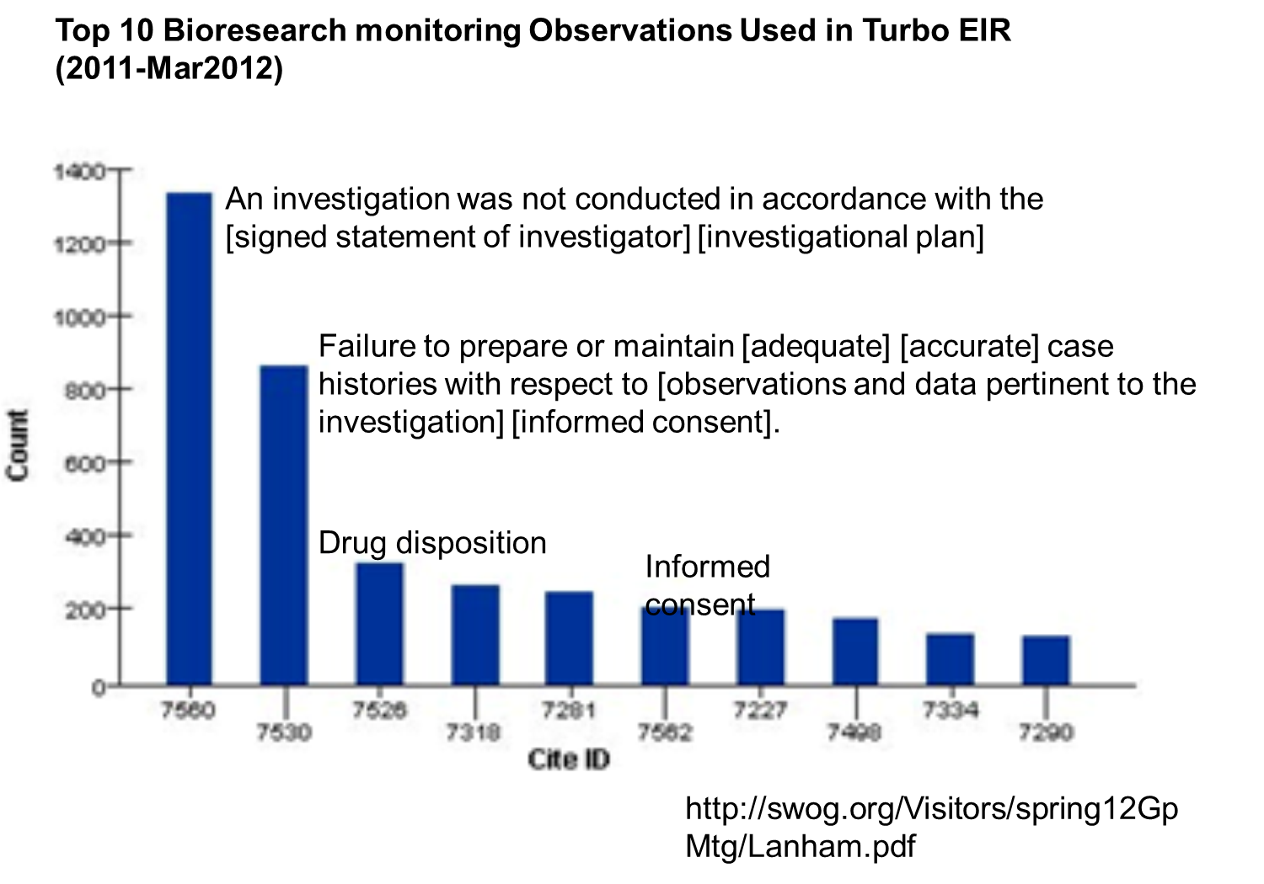
Record Retention
Both sponsor and PI have the responsibilities for maintaining trial data and documents/
The records are subject to FDA inspection for accuracy and reliability of data.

Slide 39
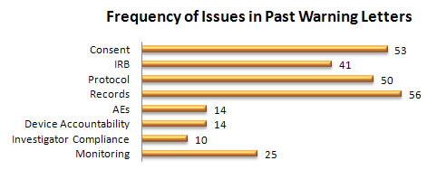
Violations Noted by FDA
Enrollment of ineligible subjects
Violation of protocol affecting safety
Extensive data corrections and questionable changes
Inadequate oversight of study personnel
  Inappropriate delegation of authority
  Poor oversight of sites
No Informed consent
Failure to communicate with IRB

Slide 40
IND Exemptions: The clinical investigation of a drug marketed in US is exempt from IND under the following situations:
There is no intent to report the investigation to FDA as a well-controlled study in support of a new indication and no intent to use it to support any other significant change in the labeling of the drug
In the case of a prescription drug, the investigation is not intended to support a significant change in the advertising for the drug
The investigation does not involve a route of administration, dose, patient population, or other factor that significantly increases the risk (or decreases the acceptability of the risk) associated with the use of the drug product (21 CFR 312.2(b)(1)(iii))

Slide 41
IND Exemptions: The clinical investigation of a drug marketed in US is exempt from IND under the following situations:
The investigation is conducted in compliance with the requirements for review by an IRB (21 CFR part 56) and with the requirements for informed consent (21 CFR part 50)
The investigation is conducted in compliance with the requirements of § 312.7 (i.e., the investigation is not intended to promote or commercialize the drug product)

Slide 42
Brain Teasers
Dr. Jones wants to conduct a clinical trial using Miracle_Aid (an oral tablet approved for curing the common cold in adults) to treat adults with ADHD disorder. Does he need an IND?
Why or why not?
Dr. Jones wants to conduct a clinical trial using Miracle_Aid (an oral tablet approved for curing the common cold in adults) to treat adults with common cold. He wants to use 2x the approved dose. Does he need an IND?
Why or why not?

Slide 43

Questions?
More Information?
Allie Karshenas, PHD, CLDir (ASCP), SS/BB
alkarshenas@hsc.wvu.edu
763 Chestnut Ridge Rd
Morgantown, WV 26505
(O) 304-581-1878

